Slide 1


What you'll learn..
Advance your software testing abilities by learning API Testing.
Good understanding of the APIs & API Testing(HTTP Basics).
How to test API using the POSTMAN(Chrome extension and monitor them using Jenkins)
How software tester in the company test API and validation used by them
Web Fundamentals & Understanding Continuous Integration Delivery in Big Companies.

Slide 2
In this Tutorial...
What is an API?
What is API Testing?
SOAP vs REST.
What are common Types of Bugs in API Testing?
REST Explained.
Installing Postman

Slide 3
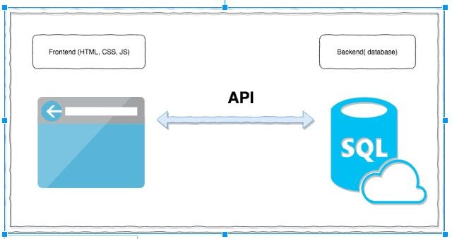
What is an API?
API stands for the Application Programming Interface,
They are basically a collection of functions
and procedures which allows us to communicate two applications or libraries.
In short, It is like a connector between two services as shown in the picture.
In one line, API is its an interface between different software programs or service.

Slide 4
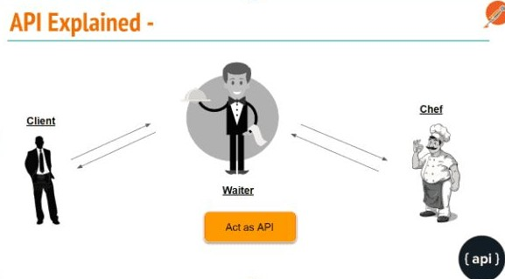
What is an API?
Suppose you go to a restaurant.
API is the messenger(waiter) that takes your order from you and tells to the chef in (kitchen), what food to be prepared and after some time waiter returns with the ordered food.
In one line, API is its an interface between different software programs or service.

Slide 5
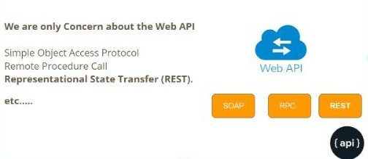
Type of APIs :-
SOAP
JSON RPC
XML RPC
REST

Slide 6
What is API Testing?
API testing is testing that APIs and its integration with the services.
It is one of the most challenging types of
testing If we miss the certain cases in API Testing that can cause a very big problem in production after full integration and it will hard to debug in the production environment…

Slide 7
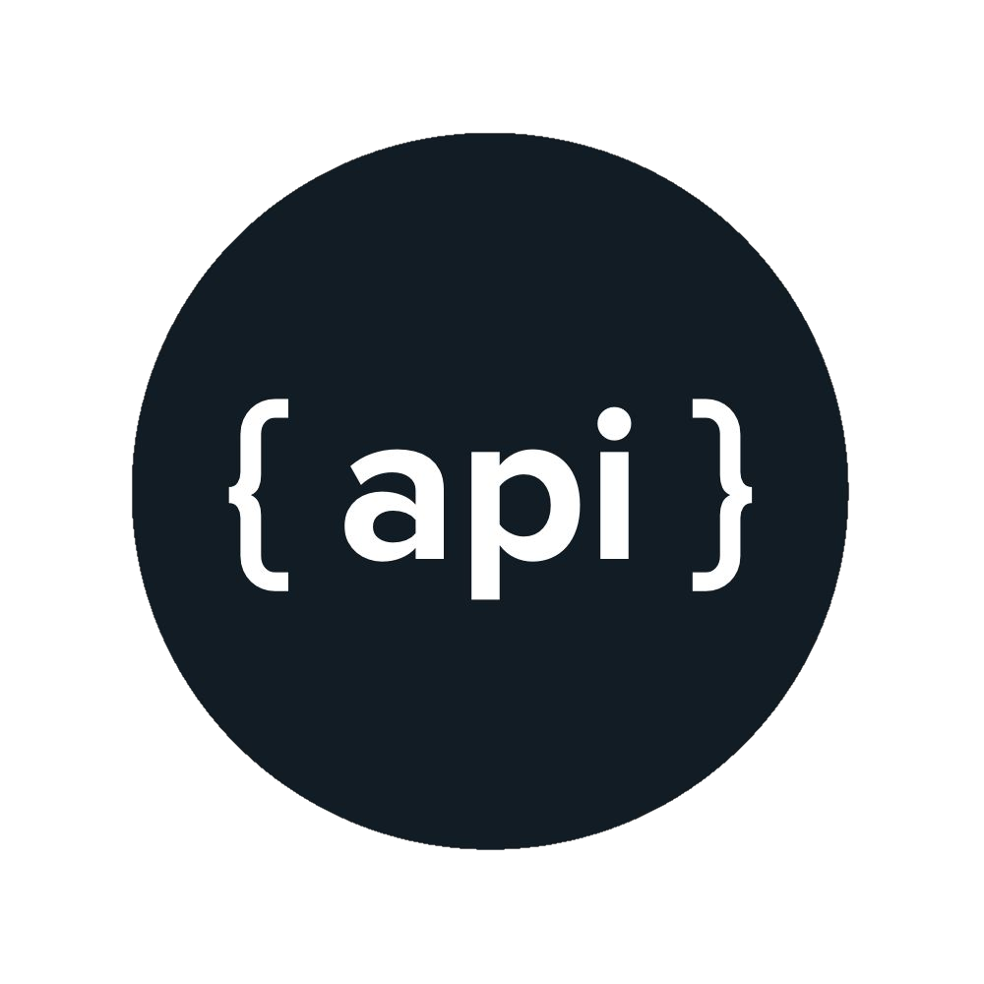
Why you should perform API Testing?
Many of the services that we use every day rely on hundreds of different interconnected APIs, if any one of them fails then the service will not work.
Right now, Internet uses millions of APIs and they should be tested thoroughly.
Developers make mistake and they create buggy APIs…
Validation of APIs is very important which are going live to production.

Slide 8
What to Test in API Testing?
Validate the keys with the Min. and Max range of APIs (e.g maximum and minimum length)
Have a test case to do XML, JSON Schema validation.
Keys verification. If we have JSON, XML APIs we should verify it’s that all the keys are coming.
Verify that how the APIs error codes handled.

Slide 9
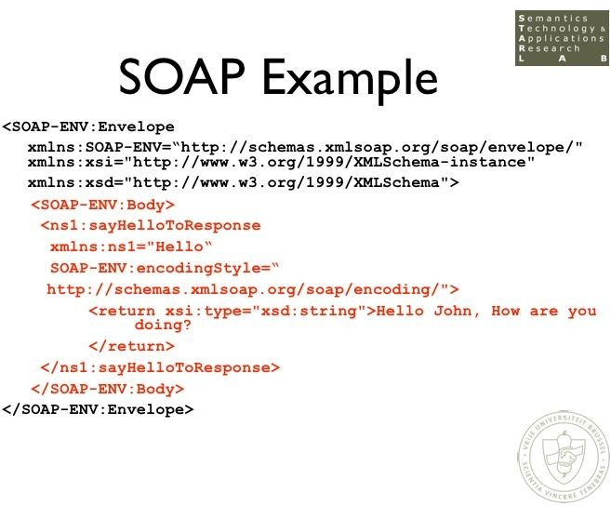
What is SOAP?
SOAP (Simple Object Access Protocol)
It is a messaging protocol that allows programs that run on disparate operating systems or services like frontend or backend to communicate using Hypertext Transfer Protocol (HTTP) and its Extensible Markup Language (XML).

Slide 10
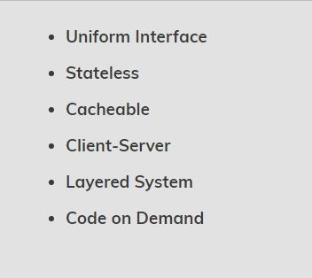
What is REST?
As REST is an acronym for
REpresentational State Transfer, statelessness is key. An API can be REST if it follows the below constraints.
The REST architectural style describes six constraints. These constraints, put on the architecture, were initially communicated by Roy Fielding in his doctoral dissertation and deﬁnes the basis of RESTful-style.

Slide 11
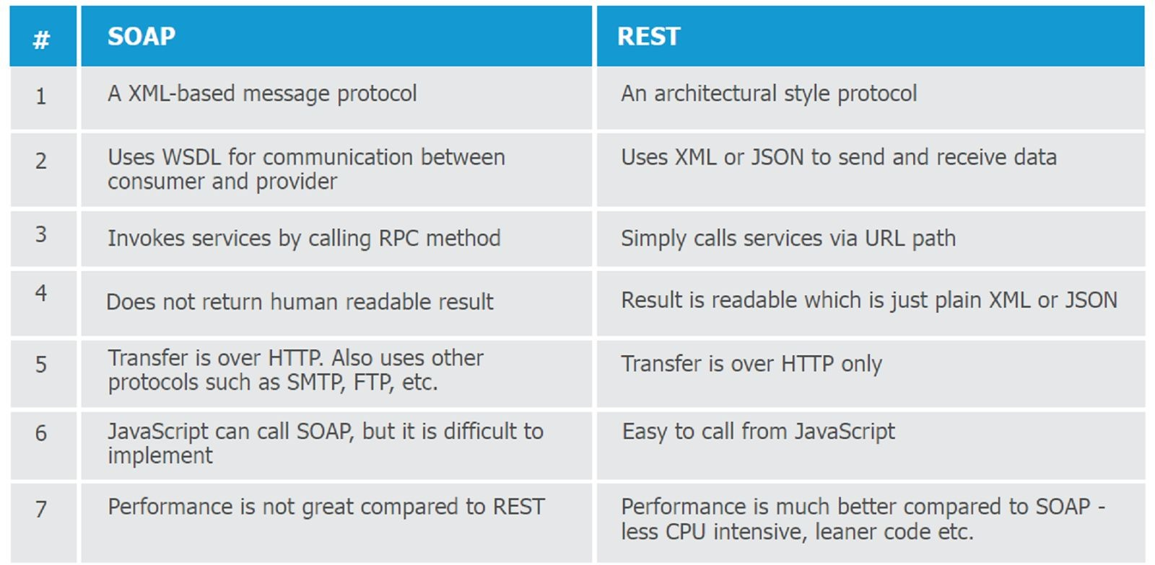
SOAP vs REST

Slide 12
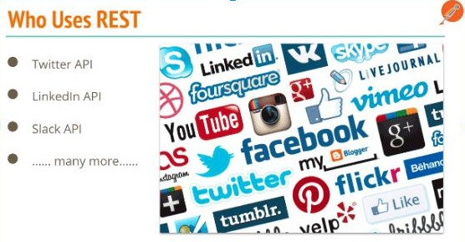
Who Users REST APIs

Slide 13
REST Constraints Explained. - Uniform Interface
The ﬁrst constraint of the REST API states that the Client and server has to communicate and agree to certain rules based on resources(they should communicate with same resource like json, xml, html , txt) and with proper encoding like UTF-8 extra.

Slide 14
REST Constraints Explained. - Stateless
APIs in REST is stateless and Client and server don’t worry about the state of the request or response..
Stateless means the server does not remember anything about the user who uses the API.
It doesn’t remember if the user of the API already sent a GET request for the same resource in the past

Slide 15
REST Constraints Explained. - Cacheable
According to the World Wide Web, clients can cache responses. Responses should, therefore, implicitly or explicitly, deﬁne themselves as cacheable. It’s up to server when they want the cache to expired etc.
This means that the data the server sends contain information about whether or not the data is cacheable.
If the data is cacheable, it might contain some sort of a version number. The version number is what makes caching possible

Slide 16

REST Constraints Explained. - Client-Server
Client and Server are two different entity, It means that servers and clients may also be replaced and developed independently, as long as the interface is not altered.

Slide 17
REST Constraints Explained. - Layered System.
It means that the between client and server there can be any number of layered systems it does not matter.

Slide 18
REST Constraints Explained. - Code on Demand
The server can store the Code or logic to themselves and transfer it whenever needed rather client-side logic.

